Slide 1
Trivalley Bike store Regression analysis

Slide 2
Content
Business Case – To identify the features impacting the Ave_Month_Spend of Customer of Trivalley Bike Store
Data Acquisition –Customer information and their yearly incomes are provided in CSV format.
Data Preparation – Missing data was found using Azure ML and steps were taken to fill the gaps
Data Visualization – Graphs were created using Tableau understand the relation of feature to the Ave_Month_Spend.

Slide 3
Data Preparation
Total number of records = 16519
98 duplicate records were found and the duplicate rows are removed from the dataset.
The number of records(without duplicates)=16421
Following missing values were found:
Title (number of missing records=16431)
Middle name(number of missing records=6985)
Suffix(number of missing records=16517)
Address line2(number of missing records=16243)
Missing values treatment:
The features with high missing values percentage are ignored from the analysis.

Slide 4
Exploratory Data Analysis
The Features (i.e., variables) are segregated into three Categories namely:
Dependent Variable (Y) – This is the Ave_Month_Spend which is to be predicted
Noise Features : Variables which would not have a significant impact on the value of Ave_Month_Spend.
Redundant
Feeder variables
Predictor Variables : Variables which were considered to have an impact on the Ave_Month_Spend.

Slide 5
Exploratory Data Analysis (contd..)
Noise Variables
Predictor Variables
Customer ID
First Name
Last Name
AddressLine1
Phone Number
Birth Date
Education
HomeOwnerFlag
Bike Buyer
AveMonthSpend | MaritalStatus
Occupation | NumberCarsOwned
City | NumberChildrenAtHome
StateProvinceName | TotalChildren
CountryRegionName | YearlyIncome
PostalCode | Gender

Slide 6
Data Visualization
Data visuals are created using Tableau where charts are plotted using the independent variables against the dependent variable (Ave_Month_Spend).
These charts help us in getting a preliminary idea about the relationship between the independent variables and the dependent variable (Ave_Month_Spend).

Slide 7
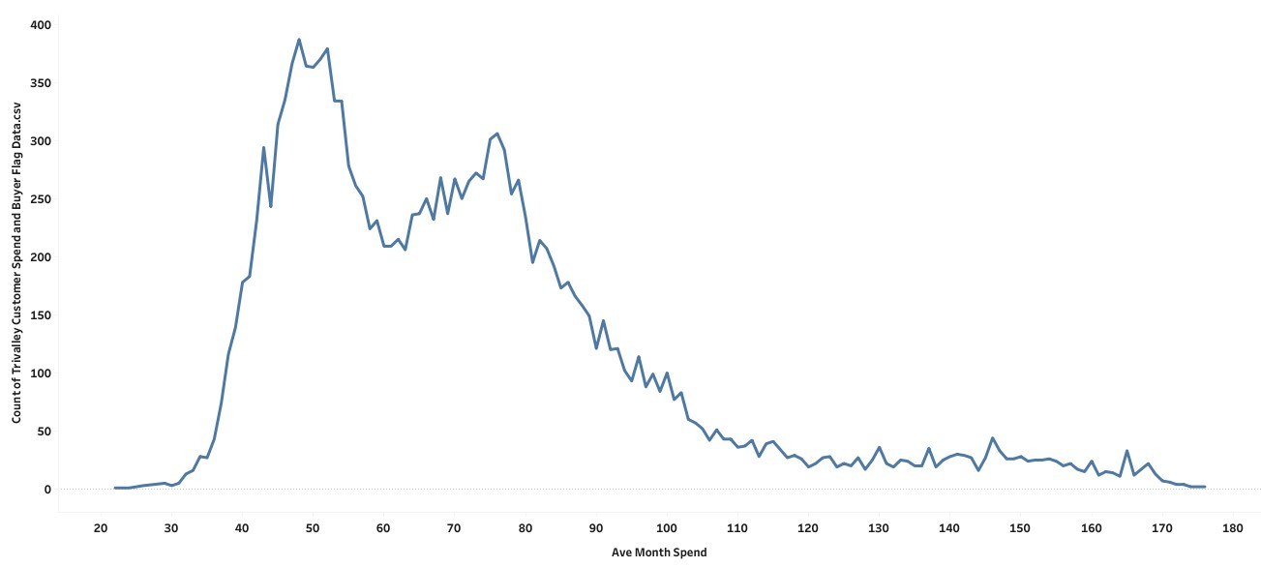
Average Month Spend of Trivalley customer
Key Highlights
The maximum number of customers would spend in the range of 60000 to 175000.
The Highest Average month spend is 176000 which is spent by the 0.012% customers.

Slide 8
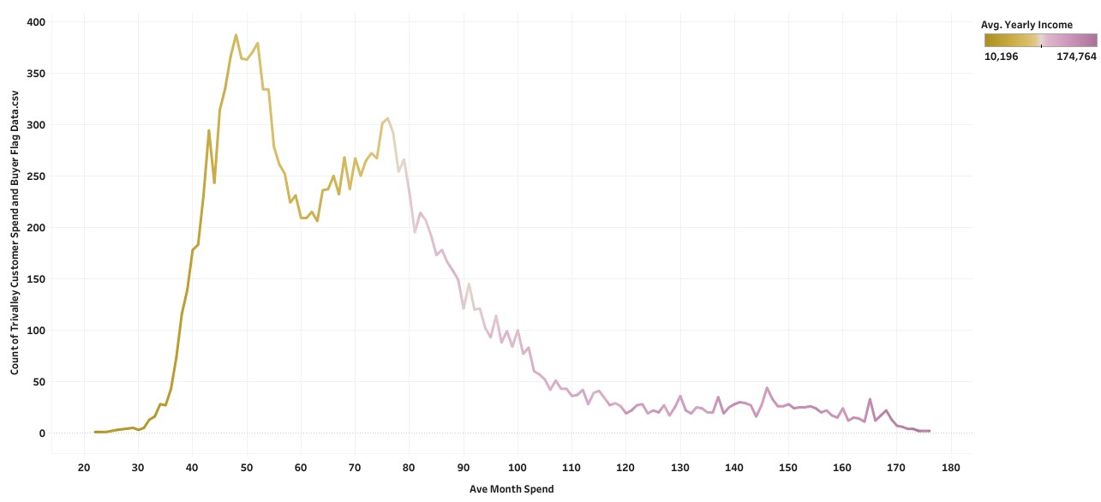
Average yearly Income Vs Average Month Spend
Key Highlights
Out of 16421 Customers , maximum number of Customers would spend in range of 430000 to 175000 for the average yearly income range 60,000 to 175000.

Slide 9
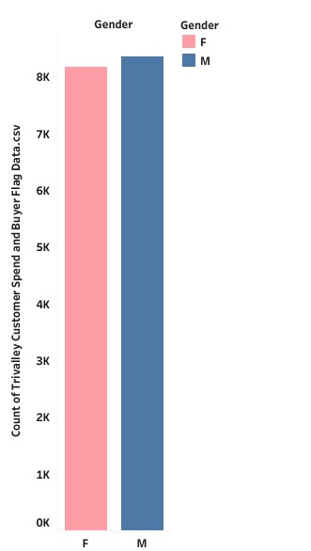
Gender
CATEGORIES
count %
Female 8120 49.449%
Male 8301 50.551%
Key Highlights
The data consists of 16421 customers
Out of 16421customers , 49.449% or 8120 were Females.
Out of 16421customers , 50.551% or 8301 were Males.

Slide 10
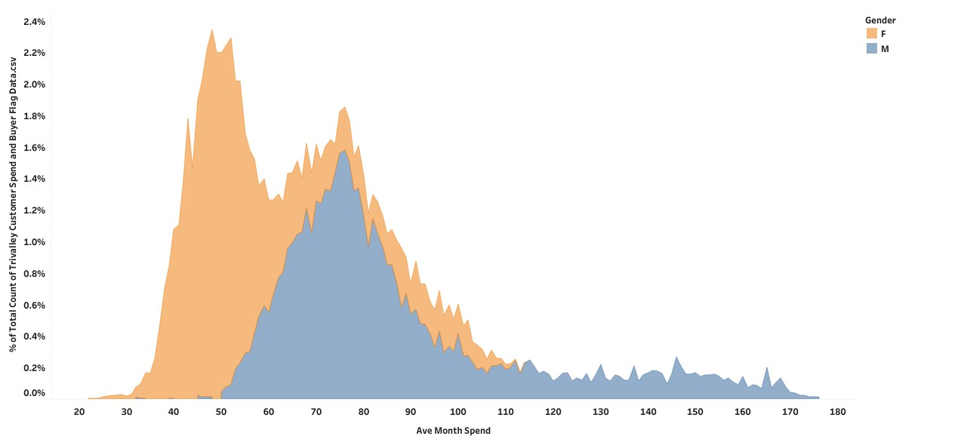
Gender Vs. Ave_Month_Spend
Out of 50.554% Males, the 8301 Males ave_month_spend is 76000.
Out of 49. 446% Females, the 8120 Females ave _month spend is 52000 .

Slide 11
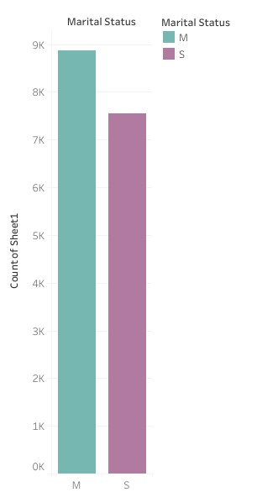
Marrital Status
CATEGORIES
Count %
Married 8864 53.980%
Single 7557 46.020%
Key Highlights
The data consists of 16519 Customers of which 8864 or 53% were Married and 7557or 46% were Singles.

Slide 12
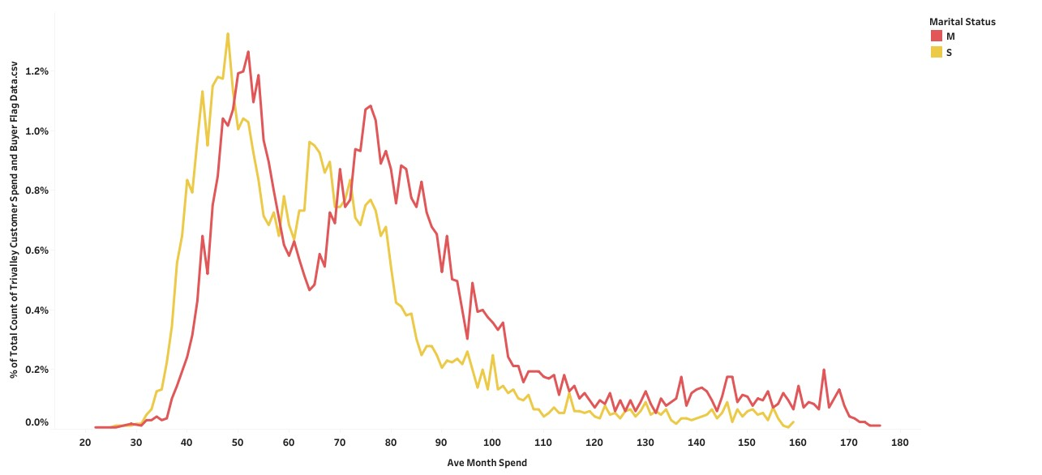
Marital Status Vs. Ave_Month_Spend
Key Highlights
Out of .16421 Customers, 7557 singles had spend their average month spend is 62000
Out of 16421 customers ,8864 married customers had spend their average month spend is 74000 .

Slide 13
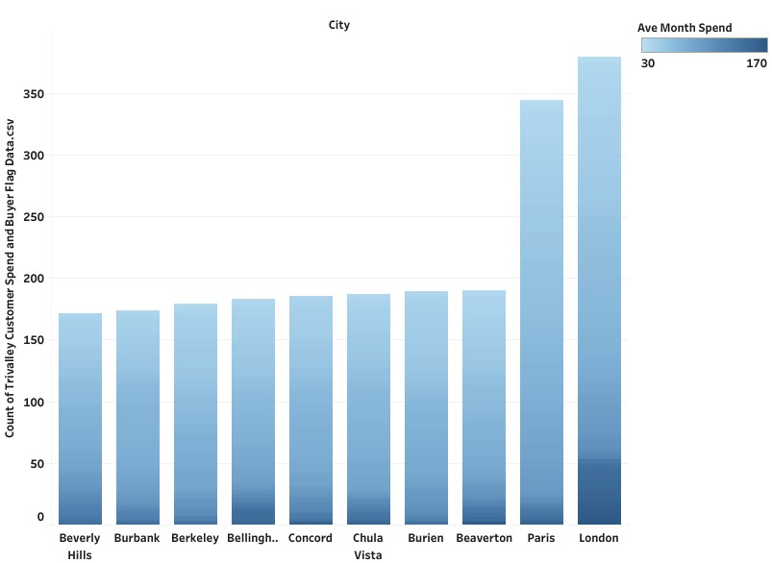
Top Ten Cities and their average month spend
Key Highlights
The highest average month spend is 170000 from the London
The lowest average month spend is 39000 from the Beverly hills.

Slide 14
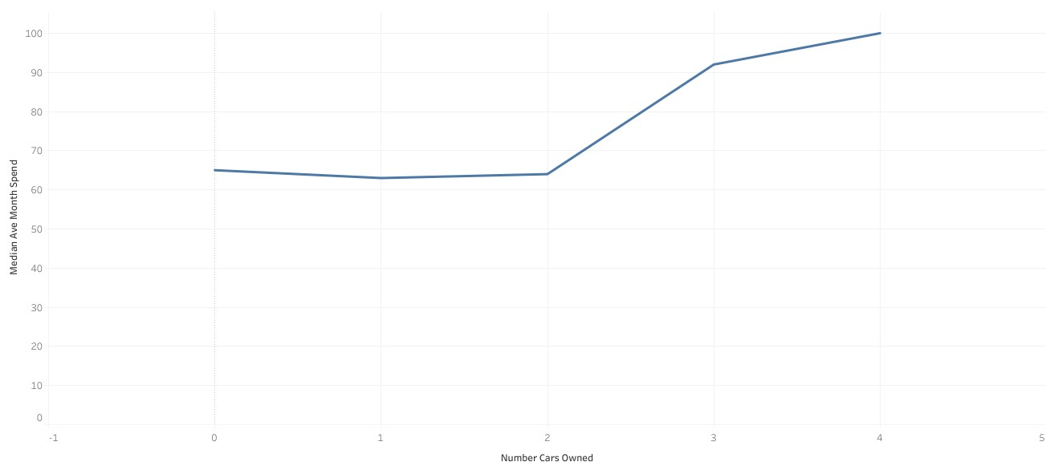
Number of Cars and Ave_Month_spend
.
23% or 3784 customers have 0 cars and their average month spend is 65000.
35% or 5747 customers have 2 cars and their average month spend is 64000.
6.886% or 1127 customers owned 4 cars and their average income is 100000.
Key Highlights

Slide 15
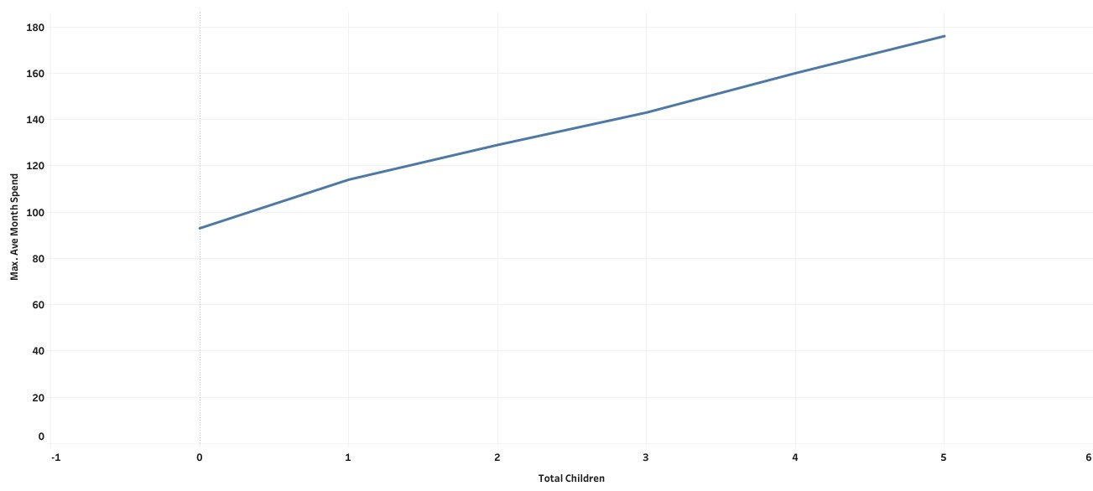
Relationship between Total Children and Avg_Month_Spend
Out of 16421customers , 25 % or 4249 of them have no children and their average month spend is 56000
out of 16421 customers,10.46% or 1715 of them would have 5 children and their average month spend is 97000.
Key Highlights

Slide 16
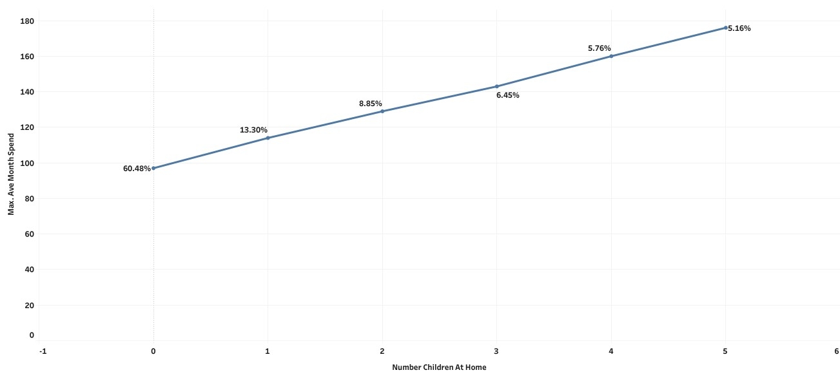
Relationship between number of Children at Home and Ave_Month_Spend
Out of 16421cutomers,60% or 9934 of them have 0 Children at Home and their average month spend is 57000.
Out of 16421Customers, 5.16% or 885 of them have 5 children at Home and their average month spend is 110000.
Key Highlights

Slide 17
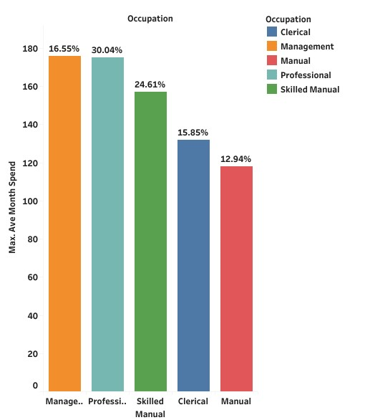
Occupation and average Month Spend
Key Highlights
Out of 16519 customers,2734 or 16.55% are Managers with average Month spend is 176000.
Out of 16519 customers , 2138 or 12.94% are manual skilled laborers with average month spend is 11800.

Slide 18
High School Chi-Squared Test Analysis
Chi-Squared Test Analysis was performed to identify list of features which impact the std score
Top Numerical features impacting the average month spend
Yearly Income
Top Categorical features impacting Average Month Spend
Independent Variable
Number of Children at home
Gender
Total Children
Number cars owned
Independent Variable
Occupation
MaritalStatus
StateProvinceName
Country Region Name
Least 5 impacting features on High School Std Score : Percent Pacific Islander, Is Magnet, Is Virtual, Is Title, Is Charter

Slide 19
High School Linear Correlation Ratio Tests Analysis
Top 3 categorical Influencing factors on AVERAGE MONTH SPEND of Trivalley Customers are : Number Of Children At Home, Gender, Total Children
Independent Variable | Correlation Ratio
Number of Children At Home | 0.73
Gender | 0.57
Total Children | 0.51
Number Cars Owned | 0.47
Occupation | 0.38
Marital Status | 0.22
State Province Name | 0.12
Country Region name | 0.11

